Slide 1
PHASE - II
INNOVATION OF STOCK PRICE PREDICTION

Slide 2
CONTENT
Credit Card Fraud Detection
Dataset
Pandas
Rest of Explanation

Slide 3
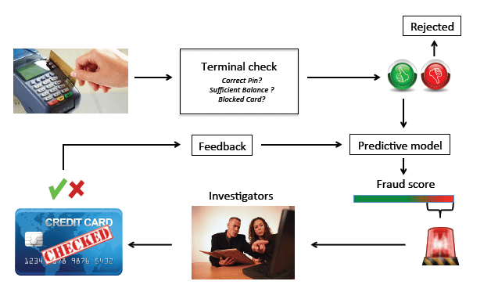
CREDIT CARD FRAUD DETECTION
Credit card fraud detection is a set of methods and techniques designed to block fraudulent purchases, both online and in-store.
Credit card fraud is “the unauthorized use of a credit or debit card, or similar payment tool to fraudulently obtain money or property.”

Slide 4
TYPES
Stealing cards
Hacking email accounts
Obtain details by calling the cardholder
Phishing through messages having fraudulent links/codes
Skimming and cloning
Donation request
Scarring cardholders with arrest calls
Attracting cardholders with offers and interest reductions
Claiming overpayment

Slide 5
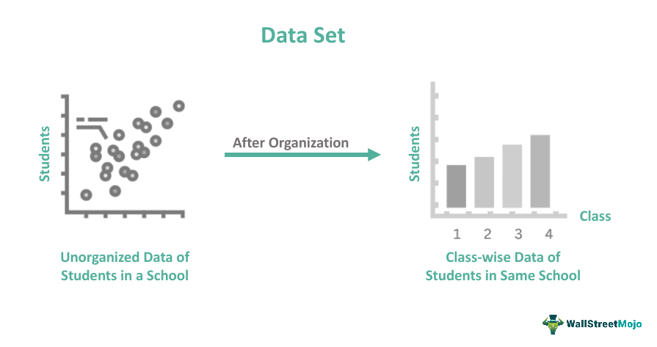
DATASET
Kaggle is one of the largest communities of data scientists and machine learning practitioners in the world, and its platform hosts thousands of datasets covering a wide range of topics and industries.
With so many options to choose from, it can be difficult to know where to start or what datasets are worth exploring. That's where this dataset comes in. By scraping information about the top 10,000 datasets on Kaggle, we have created a single source of truth for the most popular and useful datasets on the platform.
This dataset is not just a list of names and numbers, but a valuable tool for data enthusiasts and professionals alike, providing insights into the latest trends and techniques in data science and machine learning.

Slide 6

WHAT IS PANDAS IN PYTHON?
Pandas is an open-source Python library developed by Wes McKinney in 2008. It is used in data science, data analysis, and other machine-learning activities. It is very fast and provides many tools for effectively handling large amounts of data. It is built on the Numpy library.

Slide 7
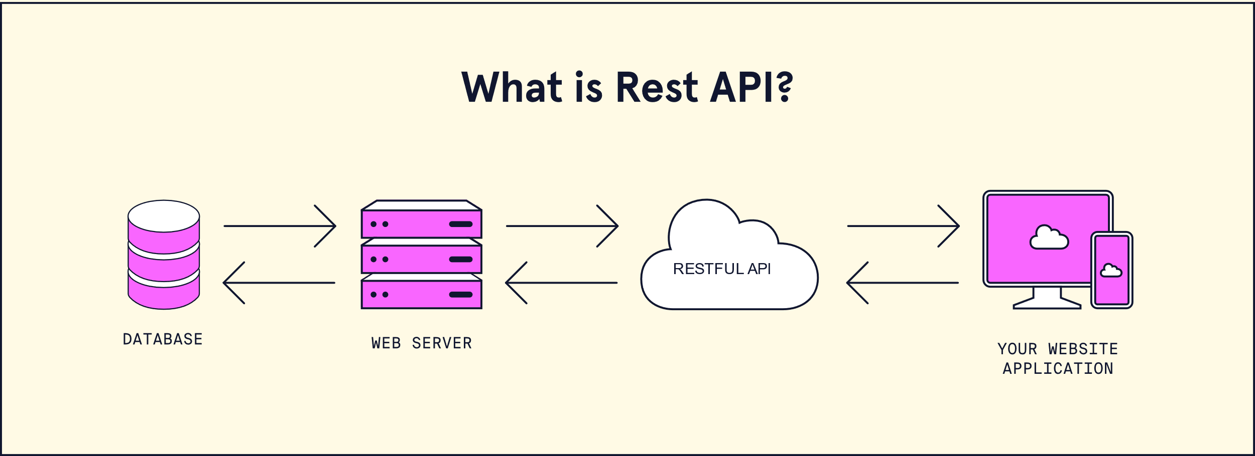
REST OF EXPLANATION:
RESTful API is an architectural style for an application program interface (API) that uses HTTP requests to access and use data. That data can be used to GET, PUT, POST and DELETE data types, which refers to the reading, updating, creating and deleting of operations concerning.
A RESTful API uses commands to obtain resources. The state of a resource at any given timestamp is called a resource representation.

